Slide 1
INFORMED SEARCHES

Slide 2
Requirements of a good search strategy:
It causes motion: Otherwise, it will never lead to a solution.
It is systematic: Otherwise, it may use more steps than necessary.
It is efficient: Find a good, but not necessarily the best, answer.

Slide 3
Heuristic Approach
Heuristic technique improves the efficiency of a search process, possibly by sacrificing claims of completeness or optimality.
Heuristic is for combinatorial explosion.
They are called weak methods.

Slide 4
Generate‐and‐Test
Generate a possible solution.
Test to see if this is actually a solution.
Quit if a solution has been found.Otherwise, return to step 1.
It is a depth-first search with backtracking.

Slide 5
Generate‐and‐Test contd…
It is also known as British Museum Algorithm.
Acceptable for simple problems.
Inefficient for problems with large space.
Exhaustive in nature.
Heuristic generate‐and‐test: It does not consider paths that seem unlikely to lead to a solution.

Slide 6
Generate‐and‐Test contd…
Example: coloured blocks.
“Arrange four 6‐sided cubes in a row, with each side of each cube painted one of four colours, such that on all four sides of the row one block face of each colour is showing.”

Slide 7
Generate‐and‐Test contd…
Heuristic:
If there are more red faces than other colours then, when placing a block with several red faces, use few of them as possible as outside faces.

Slide 8
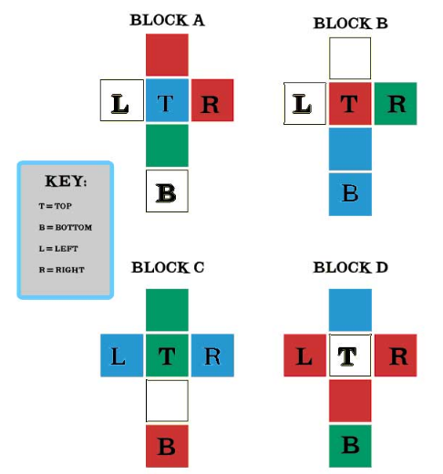
Generate‐and‐Test contd…

Slide 9
Generate‐and‐Test contd…
First successful AI program which uses plan-generate-test is DENDRAL.
It infers the structure of organic compounds using mass spectogram and nuclear magnetic resonance(NMR).
A planning process that uses constraint-satisfcation techniques creates lists of recommended and constraindicated substructures.
The generate and test procedure has proved highly effective.

Slide 10
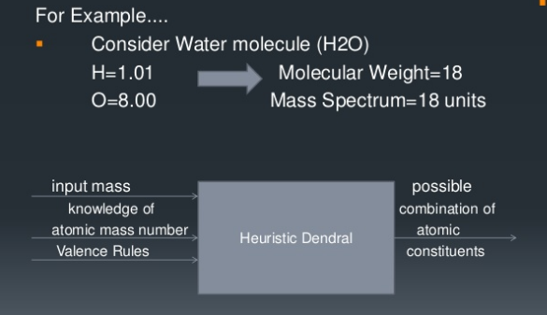
Generate‐and‐Test contd…

